Slide 1
CREATING A DIGITAL FORENSIC LABORATORY
Godwin S. Monserate

Slide 2
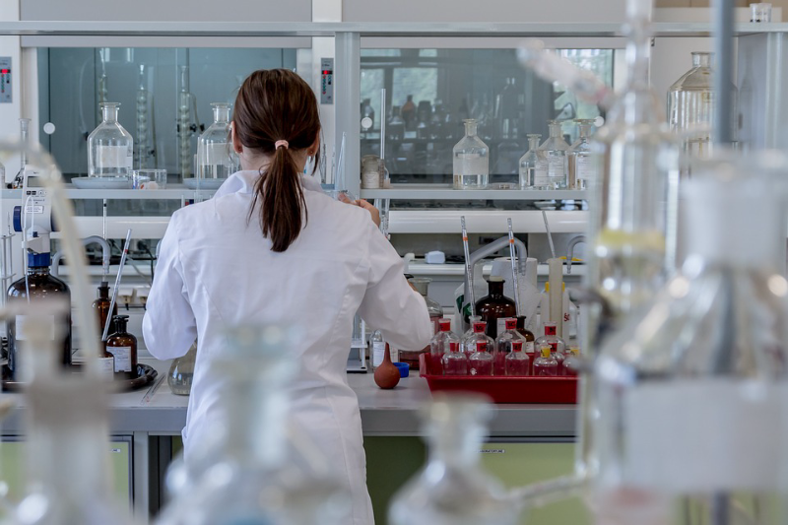
CREATING A DIGITAL FORENSIC LABORATORY
Creating a digital forensic laboratory is a responsible step. The effectiveness of the laboratory depends on what software, hardware and equipment will be purchased.

Slide 3
A FORENSIC WORKSTATION
Choosing a workstation configuration is an important step. The effectiveness of digital examiners depends on the way the workstation is configured.
However, we want to pay special attention to one point: the workstation should work as quietly as possible. Imagine an open space where several powerful computers are installed, each of which makes a noise like a server. The employees’ headache and poor health are guaranteed. Silent workstation performance is achieved by using low-noise fans and passive cooling systems.
Do not use top hardware. The idea to buy the most expensive processor, memory, motherboard for your new workstation is not the best one.
This configuration is optimal today:
OS: Windows 10 Pro 64-bit
CPU (2): E5-2660 v4 (14 core)
RAM: 64 GB DDR-42133 ECC
OS Drive: 1 TB SSD
Temp/Cache/DB Drive: 256 GB SSD
Data Drive: 8 TB 7200rpm
RAID Drives: 5×4 TB 7200rpm
Video Card: GeForce GTX 1080

Slide 4
A FORENSIC WORKSTATION
It is recommended to use two or more monitors for each workstation.
The most effective work is achieved when a digital examiner uses two workstations in its work.
Use Storages to store cases, forensic images, etc. Storages with a volume of 100-150 TB proved to be quite effective.
Use 10Gbit Net Cards. They will allow you to transfer data from the workstation to storages quickly.

Slide 5
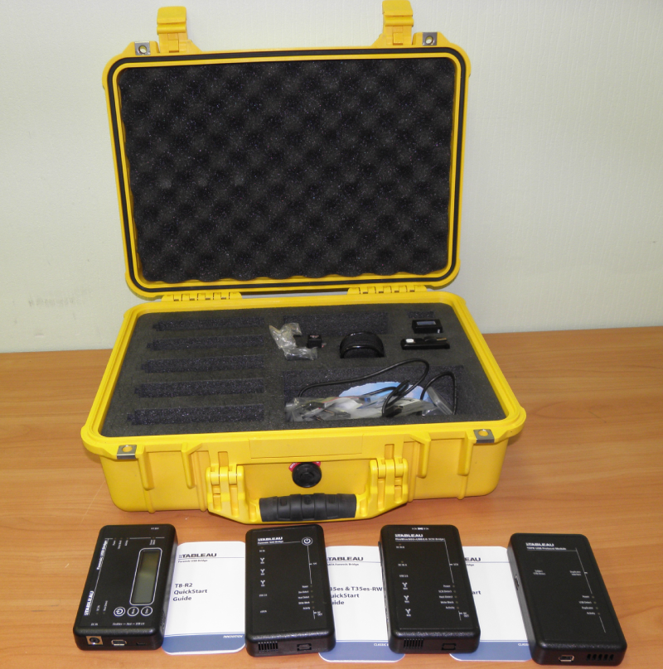
FORENSIC SOFTWARE
It’s a good idea to have as more different forensic software in the digital laboratory.
This will allow a forensic examiner to make cases as quickly and efficiently as possible. Also, this makes it possible to recheck the results of the research effectively.
However, if you have a limited budget, we recommend buying this software:
Windows 10 Pro, Office 365
Antivirus software, X-ways Forensic
AXIOM (Magnet Forensics)
The rest of the tools can be purchased as the laboratory develops.

Slide 6
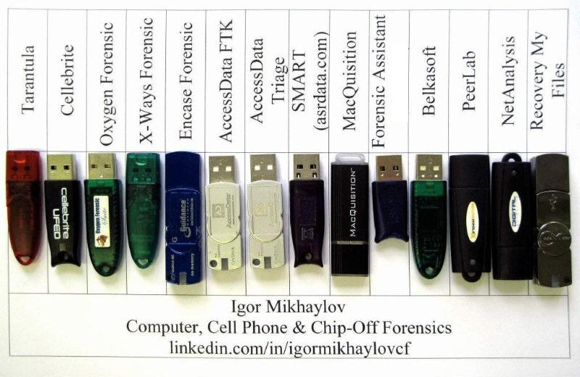
FORENSIC SOFTWARE
Also, a lot of research can be done using freeware tools.
Sometimes these tools outperform functionality of commercial tools.

Slide 7
CASE MANAGEMENT SOFTWARE
The digital forensic laboratory in a government organization, for example in the police department, then most likely they have their own case management software and then your task is just to add a new laboratory to the network of existing ones.
In other cases, you can use free and chargeable CRM systems. Besides, some CRM systems can be adapted to your management needs.
Ex. Kirjuri (Kirjuri is a web application for managing cases and physical forensic evidence items.)
Lima Forensic Case Management of all the specialized tools.

Slide 8
VIDEO FORENSICS
Use a separate workstation for the production of video forensics cases. The following forensic tools are recommended for this task:
DVR Examiner
Amped FIVE
Elecard
Very good results of recovering deleted videos can be obtained using X-ways Forensic.

Slide 9
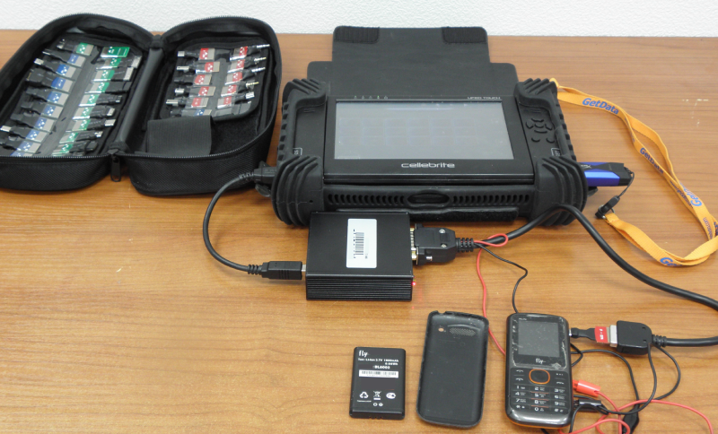
MOBILE FORENSICS
We recommend using a separate workstation to carry out mobile forensics research.
There are a lot of tools for mobile forensics. That is why it is difficult for a beginner to understand what they need to carry out this research effectively. Using the following mobile forensic tools will help you achieve your objective:
UFED 4PC (with CHINEX, UFED Camera Kit)
Cellebrute UFED Touch

Slide 10
MOBILE FORENSICS
Oxygen Forensics DETECTIVE
Oxygen Forensic Detective is an all-in-one forensic software platform built to extract, decode, and analyze data from multiple digital sources: mobile and IoT devices, device backups, UICC and media cards, drones, and cloud services. Oxygen Forensic® Detective can also find and extract a vast range of artifacts, system files as well as credentials from Windows, macOS, and Linux machines.
XRY
XRY is a digital forensics and mobile device forensics product by the Swedish company Micro Systemation used to analyze and recover information from mobile devices such as mobile phones, smartphones, GPS navigation tools and tablet computers. It consists of a hardware device with which to connect phones to a PC and software to extract the data.
Elcomsoft Mobile Forensic Bundle
includes a number of tools to acquire and analyze evidence from a number of mobile platforms. Physical and logical acquisition of iOS devices Extract evidence from 64-bit iOS devices with or without a jailbreak.

Slide 11
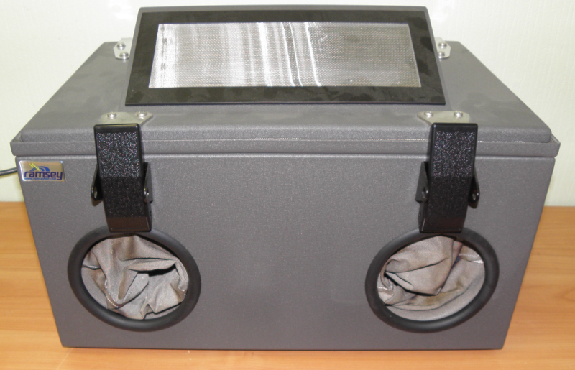
MOBILE FORENSICS
SР Flash tool to retrieve data from MTK based phones.
SP flash tool is an application which mainly helps you to flash Stock ROM, Custom recovery and fixing in some extreme cases (firmware update, Flash recovery, unbrick bricked Android device etc.).
SmartPhone FlashTool is working with MediaTek Android smartphones (MTK based) You can Download SPFlashTool from our downloading section.

Slide 12
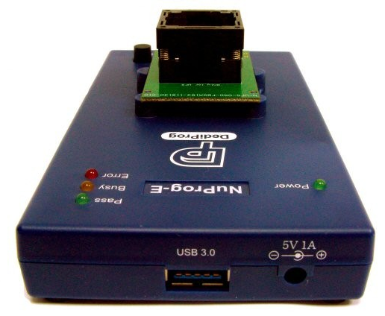
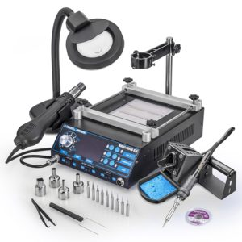
MOBILE DATA RECOVERY
Use flashers for JTAG research:
Easy Z3x JTAG BOX
Octoplus Box
Samsung anyway S101
For Chip-off we recommend using:
VISUAL NAND RECONSTRUCTOR (STARTER KIT, Rusolut)
SMARTPHONE KIT (Rusolut)
CHINESE SMARTPHONE KIT (Rusolut)
NuProg-E UFS/EMMC Programmer
IN-UFS-Socket BGA Opentop
N-UFS-065-BGA095-115130-02O BGA Opentop
N-UFS-050-FBGA153-115130-02O BGA Opentop
Use Weller WHA 300 Hot Air Reworking Station or Ersa HR100 Hybrid Rework system for disordering chips.

Slide 13
CLOUD FORENSICS
Use the following tools for Cloud forensics:
UFED Cloud Analyzer
Oxygen Forensics DETECTIVE
Elcomsoft Cloud eXplorer

Slide 14
DATA RECOVERY (HARD DRIVES, FLASH DRIVES, MEMORY CARDS)
Use a separate workstation for the production of Data recovery. You will need special hardware and tools for data recovery:
PC-3000 Express Professional System (Acelab)
Data Extractor Express (Acelab)
PC-3000 Flash (Acelab)

Slide 15
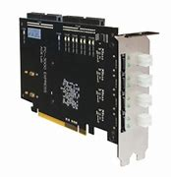
DATA RECOVERY (HARD DRIVES, FLASH DRIVES, MEMORY CARDS)
Hardware and tools for data recovery:
PC-3000 Express Professional System (Acelab)
is the fastest, most efficient and most powerful hardware-software solution for recovering data from damaged HDDs based on SATA (Serial ATA) or PATA (IDE) interfaces for numerous vendors

Slide 16
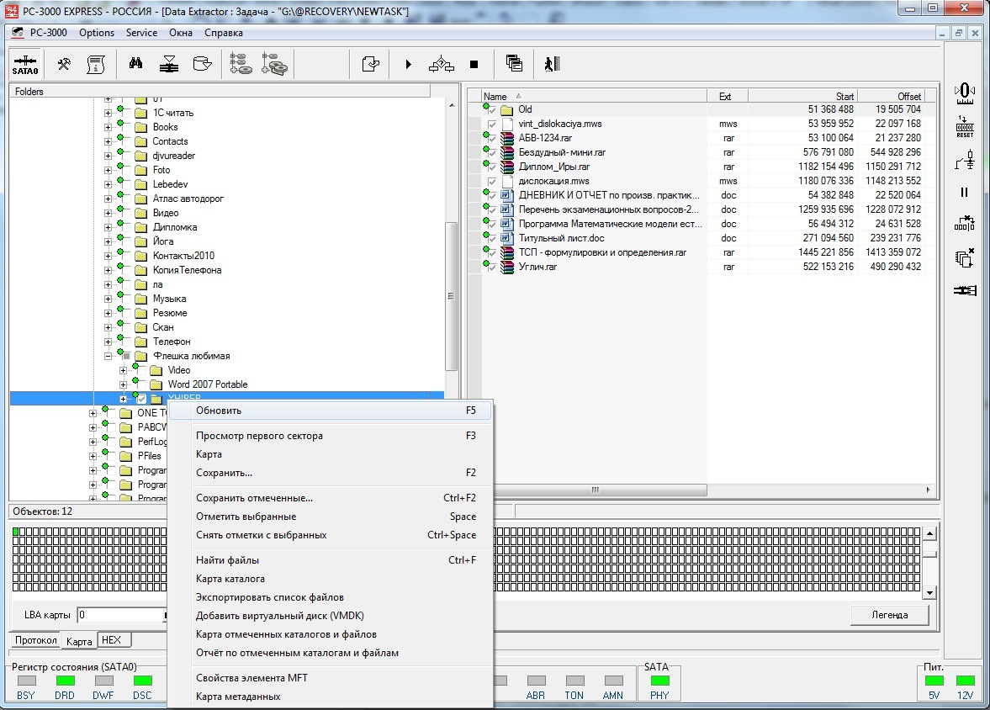
DATA RECOVERY (HARD DRIVES, FLASH DRIVES, MEMORY CARDS)
Data Extractor Express (Acelab)
PC-3000 Flash (Acelab)
The Data Extractor Express is a specialized software product functioning in tandem with the PC-3000 Express hardware-software product.

Slide 17
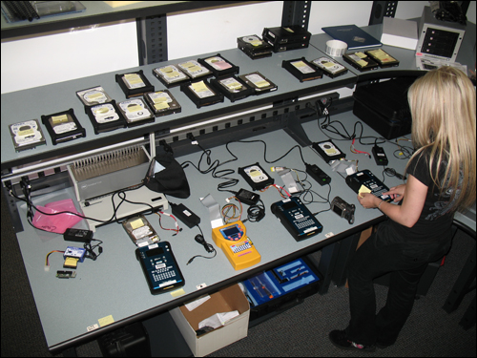
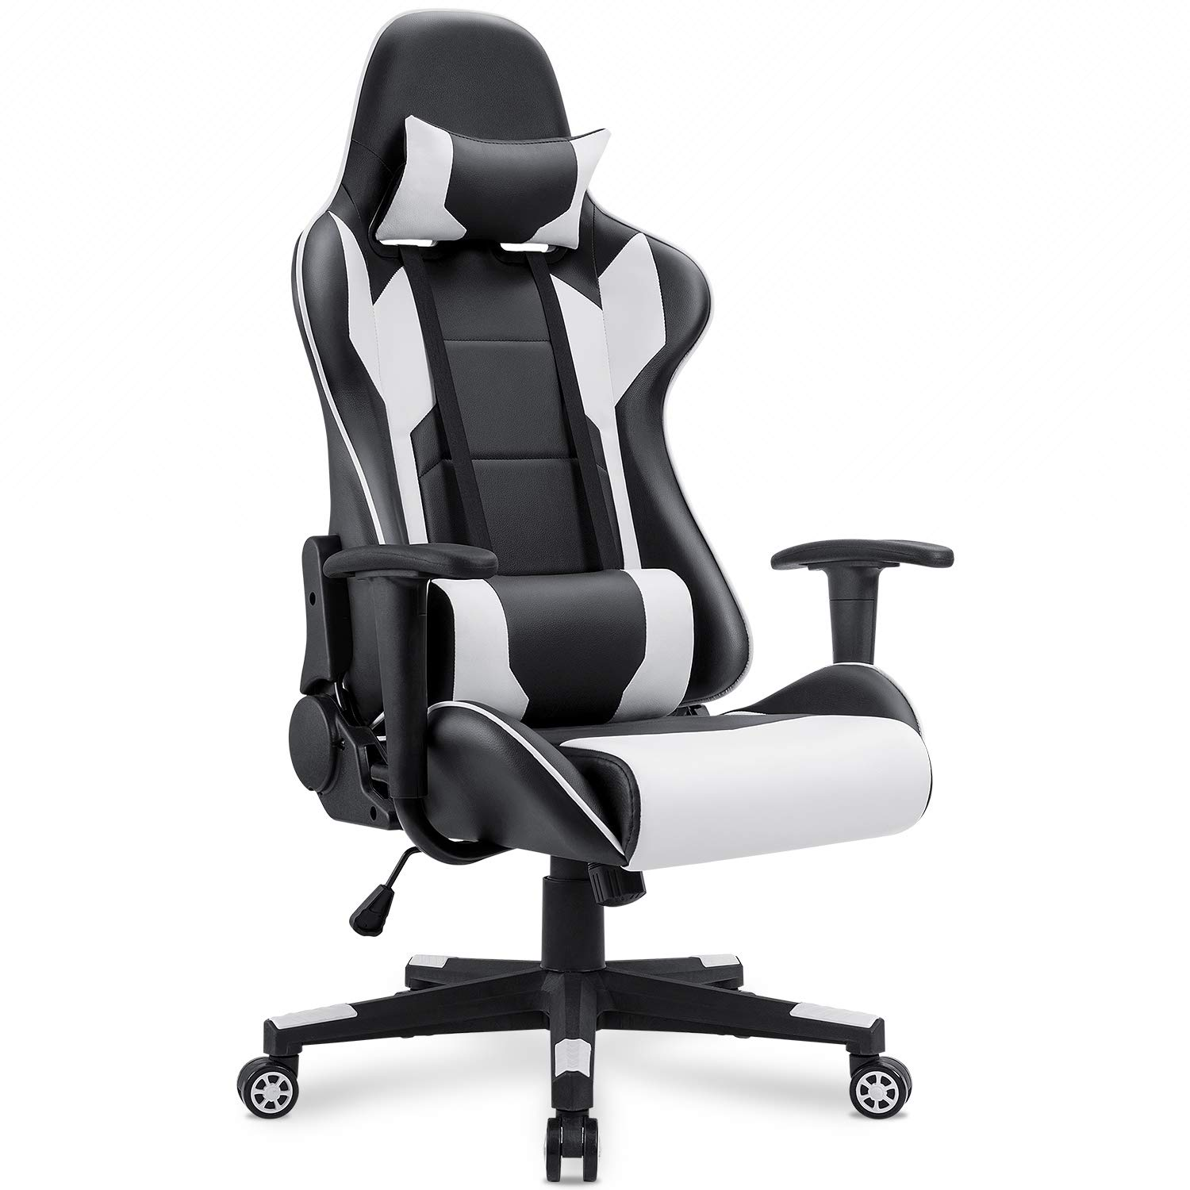
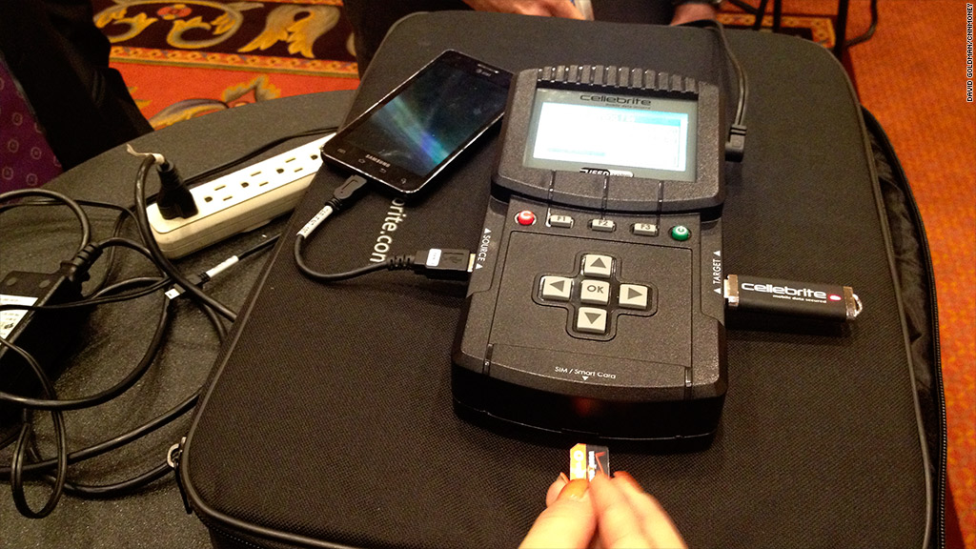
FURNITURE
Many people believe that it is enough to buy ordinary office desks and chairs to equip a digital forensic lab
Tables must have abrasion resistant coatings.
Office chairs should be as convenient as possible.
The table where the electronic equipment is assembled and disassembled should be equipped with an antistatic mat and an antistatic bracelet.

